Slide 1
Linear Regression
Notes:
In this video, we’ll learn what linear regression is and how we can use it to make predictions!

Slide 2
Linear Regression
Linear regression is an attempt to create a linear relationship between two correlating variables.
Notes:
Linear regression is an attempt to create a linear relationship between two variables that have a correlation. Let’s take a look at how this works.

Slide 3
Finding Line of Best Fit
Notes:
Using data, Linear Regression creates a line of best fit, which is used to make predictions. Data used in linear regression can often be represented using a scatterplot.

Slide 4
Finding Line of Best Fit
Independent Variable (Movie Ticket Sales)
Notes:
The x-axis is typically reserved for independent variables. These are the variables or data points that shape and impact the outcome of a model. In this example, we'll use movie ticket sales.

Slide 5
Finding Line of Best Fit
Dependent Variable (Popcorn Sales)
Independent Variable (Movie Ticket Sales)
Notes:
The y-axis represents the dependent variable. This variable directly depends on the independent variable. In our example here, popcorn sales are directly affected by movie ticket sales. This means that there is a relationships between both variables, and that as the value of movie ticket sales changes, the value of popcorn sales is likely to change as well.

Slide 6
Finding Line of Best Fit
Dependent Variable (Popcorn Sales)
Independent Variable (Movie Ticket Sales)
Notes:
If we were to populate this graph with data points, we might begin to see a relationship between the variables. As the number of movie ticket sales increases, the number of popcorn sales also increases. This data can be used along with linear regression to determine a line of best fit.

Slide 7
Finding Line of Best Fit
The line of best fit is the line that best expresses the relationship between all data points.
Dependent Variable (Popcorn Sales)
Independent Variable (Movie Ticket Sales)
Notes:
The line of best fit is the line, or linear equation that best expresses the relationships between all data points.

Slide 8
Finding Line of Best Fit
A line is considered to be the best fit if it has the smallest total distance from each data point.
Dependent Variable (Popcorn Sales)
Independent Variable (Movie Ticket Sales)
Notes:
A line is considered to be the best fit if it has the smallest total distance from each data point.

Slide 9
Finding Line of Best Fit
This is probably not the line of best fit because the distance of each data point to the line is significant.
Dependent Variable (Popcorn Sales)
Independent Variable (Movie Ticket Sales)
Notes:
For example, if we were to try to approximate a line of best fit, this would probably not be the line of best fit because the distance of each data point to the line is pretty significant. Think about it this way. If the line is supposed to represent a predicted result, then the distance between the actual data and the predicted result needs to be pretty close in order for the line to be best fit. Since the actual results are far away from the predicted results, the line must not be the best fit.

Slide 10
Finding Line of Best Fit
This is a better fit line because the total distance from each data point is smaller.
Dependent Variable (Popcorn Sales)
Independent Variable (Movie Ticket Sales)
Notes:
If we attempted another approximation, we could see that this is a better fitting line, as the distance between the predicted results and the actual results are much smaller.

Slide 11
Finding Line of Best Fit
Dependent Variable (Popcorn Sales)
The line of best fit can be calculated using the least squares method.
Independent Variable (Movie Ticket Sales)
Notes:
While we can make approximations visually to determine the line of best fit, linear regression is able to determine the line of best fit by using a function referred to as the least squares method.

Slide 12
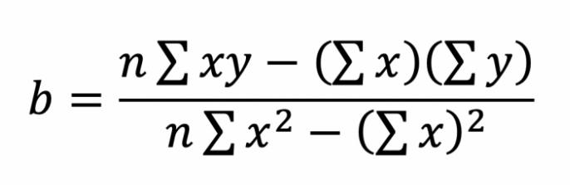
Finding Line of Best Fit
Dependent Variable (Popcorn Sales)
The line of best fit can be calculated using the least squares method.
Independent Variable (Movie Ticket Sales)
Notes:
The least squares method is a statistical formula that is able to determine the total distance between all data points and their respective place on the predicted line. Linear regression starts by approximating a line of best fit, and uses the least squares method to determine which line has the minimum distance between all points. And again - our python libraries can help us with this!

Slide 13
Finding Line of Best Fit
y = mx + b
Linear regression returns a linear equation that models the relationship between independent and dependent variables.
Dependent Variable (Popcorn Sales)
Independent Variable (Movie Ticket Sales)
Notes:
Using the least square method to determine the line that fits the data in the best way, linear regression returns a linear model that represents this line. This linear model often resembles a linear equation that you may have seen in math classes: y = mx + b.

Slide 14
Finding Line of Best Fit
dependent variable
y = mx + b
Dependent Variable (Popcorn Sales)
Independent Variable (Movie Ticket Sales)
Notes:
The y value represents the dependent variable.

Slide 15
Finding Line of Best Fit
slope
y = mx + b
Dependent Variable (Popcorn Sales)
Independent Variable (Movie Ticket Sales)
Notes:
m represents the slope of the linear model. Slope determines how steep the line is, or how much a dependent variable changes compared to the independent variable. The slope can also be referred to as the coefficient or the gradient.

Slide 16
Finding Line of Best Fit
independent variable
y = mx + b
Dependent Variable (Popcorn Sales)
Independent Variable (Movie Ticket Sales)
Notes:
X represents the independent variable,

Slide 17
Finding Line of Best Fit
y intercept
y = mx + b
Dependent Variable (Popcorn Sales)
Independent Variable (Movie Ticket Sales)
Notes:
and b represents the y intercept, or the value of y when x is zero.

Slide 18
Finding Line of Best Fit
y = 2x + 15
Dependent Variable (Popcorn Sales)
Independent Variable (Movie Ticket Sales)
Notes:
When a linear regression algorithm is called on a dataset, it creates a line of best fit with real values for the slope, and the y-intercept. This equation can then be used to make predictions about new data that is input into the model.

Slide 19
Finding Line of Best Fit
y = 2x + 15
Dependent Variable (Popcorn Sales)
200
Independent Variable (Movie Ticket Sales)
Notes:
For example, if we were interested in knowing what popcorn sales would look like if 200 movie tickets were sold, this data point could be input into the linear equation to predict a result.

Slide 20
Finding Line of Best Fit
y = 2(200) + 15
Dependent Variable (Popcorn Sales)
200
Independent Variable (Movie Ticket Sales)
Notes:
Since x represents the independent variable, we can plug 200 into the model, and calculate the value of y.

Slide 21
Finding Line of Best Fit
415 = 2(200) + 15
Dependent Variable (Popcorn Sales)
200
Independent Variable (Movie Ticket Sales)
Notes:
The end result here is 415. This indicates that the linear model predicts 415 bags of popcorn will be sold if 200 movie tickets are sold.

Slide 22
Finding Line of Best Fit
415 = 2(200) + 15
This number is not always exactly accurate, but it provides a realistic prediction based on past data!
Dependent Variable (Popcorn Sales)
200
Independent Variable (Movie Ticket Sales)
Notes:
It's important to know that the number that is predicted won't always represent the exact number of popcorn sold if 200 tickets are sold. The line of best fit is able to provide realistic predictions because it attempts to fit the data as best as possible, but even in the graph above, it's clear that some of the data points exist above and below the predicted line. While the results of a linear regression model provide accurate results, they don't always predict the future!

Slide 23


Linear Regression in Action
Regression models are often used to help calculate the value of a car!
Companies ask for data about the car, such as its year and mileage, and compute its worth based on previous sales and purchases.
Notes:
Linear regression is a popular predictive model. One place where they are frequently used is in car sales. Companies that sell cars often ask for information about your car, like it's make and model, and calculate its worth based on previous sales and purchases. Some use linear regression models to help make those estimates about your car's total worth!

Slide 24
Limits of Linear Regression
While linear models are a powerful predictive tool, they have their limitations:
Notes:
While linear models are a powerful predictive tool, they have some limitations.

Slide 25
Limits of Linear Regression
While linear models are a powerful predictive tool, they have their limitations:
Can only be used on data that has a linear relationship.
Notes:
For one, linear regression can only be used on data that has a linear relationship. That is, the independent and dependent variables increase or decrease at similar rates.

Slide 26
Limits of Linear Regression
While linear models are a powerful predictive tool, they have their limitations:
Can only be used on data that has a linear relationship.
Can only be used on data that has a strong correlation.
Notes:
It also works best on data that has a strong correlation. A linear model will not work well or effectively predict values if there is a low or no correlation between the two variables.

Slide 27
Limits of Linear Regression
While linear models are a powerful predictive tool, they have their limitations:
Can only be used on data that has a linear relationship.
Can only be used on data that has a strong correlation.
Outliers in the data can affect the line of best fit.
Notes:
And lastly, outliers in data, or data points that stray away from the given pattern can impact the line of best fit, causing the accuracy of the model to decrease.

Slide 28
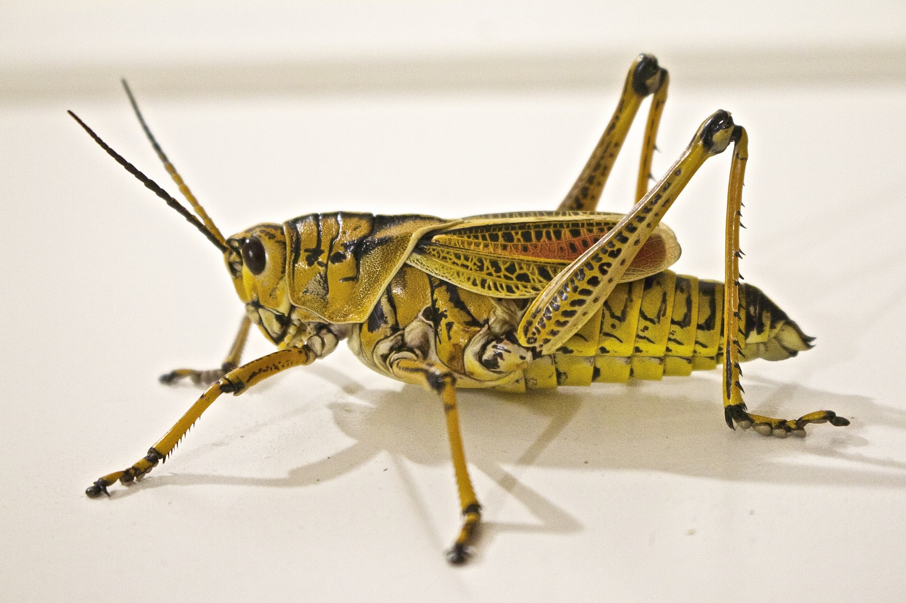
Linear Regression
Temperature | Chirps/Minute
80.5 | 44
78.5 | 46
78 | 43
73.5 | 35
70.5 | 35
68 | 32
66 | 28.9
65 | 27.7
61.5 | 25.5
57 | 20.4
55 | 12.5
Once you have determined that a dataset has a linear correlation, you can develop a linear regression model.
chirp chirp chirp
Notes:
Once you have determined that a dataset has a linear correlation, you can develop a linear regression model. For this video, we’ll be working with a dataset that relates the temperature to the number of cricket chirps per minute.

Slide 29
Linear Regression
import pandas as pd
import numpy as np
import matplotlib.pyplot as plt
df = pd.read_csv (r"chirping.csv")
Notes:
We’ll need to use a few python libraries to plot the line of best fit. We’ll use pandas and matplotlib of course - but numpy will be the one to actually help us determine the linear regression.

Slide 30
Linear Regression
# Set values for x and y
x = df.temperature
y = df.chirps
# Determine correlation
correlation = y.corr(x)
print(correlation)
0.980744730057756
Notes:
First, we’ll set the values for x and y. The independent variable is the temperature and the dependent variable is the number of chirps. Then, we’ll check to see if there is a correlation between the two. There is! A very strong positive correlation. Let’s plot this on a scatterplot.

Slide 31
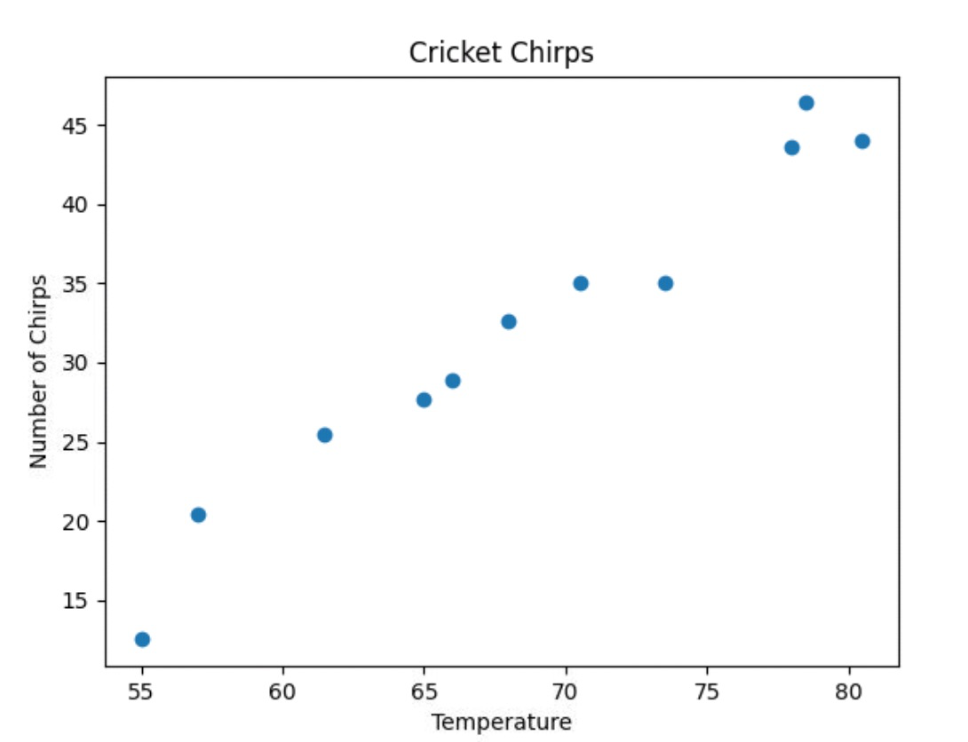
Linear Regression
# Add labels
plt.title("Cricket Chirps")
plt.xlabel("Temperature")
plt.ylabel("Number of Chirps")
# Plot the scatterplot
plt.scatter(x, y)
Notes:
Here we add labels and a title and plot a scatterplot of x and y. We can definitely see that there is in fact a strong positive correlation. As the temperature increases, the number of chirps increases as well.

Slide 32
Linear Regression
# Create the model
model = np.polyfit(x, y, 1)
print(model)
[ 1.18558015 -49.24860374]
y = mx + b
y = 1.19x - 49.25
Notes:
Great! Now we can use numpy and a new polyfit function to find the line of best fit and create a model equation. This function requires the xvalues, the yvalues and the 1 you see here is denoting the type of equation we would like to use. A linear equation has a degree (or leading exponent) of 1. If we put 2 here - we would get a quadratic equation. A 3 would give us a cubic equation, but we want a linear equation so this will always be 1 for now.
If we print the model, it will list the values of m and b to create our line of best fit! The m is 1.185 or 1.19 and the b value rounds to -49.25. This gives us y = 1.19x - 49.25.

Slide 33
Linear Regression
# Determine the min and max values of the x-axis
print(df.temperature.min())
print(df.temperature.max())
55.0
80.5
Notes:
Let’s use this model to plot the line of best fit. We’ll want to set the x-values to match the data. You might be able to look at the dataset and see the minimum and maximum values of temperature, but we can also always use the min and max functions. We can now see that the minimum temperature is 55 and the max is 80.5. We’ll use these values to set up the x-values of the best fit line.

Slide 34
Linear Regression
# Determine the min and max values of the x-axis
print(df.temperature.min())
print(df.temperature.max())
# Set the x-values of the line of best fit
x_lin_reg = range(55, 81)
55.0
80.5
Notes:
We can use the range function to create a range of numbers from 55 to 81. We’ll choose 81 because the range function can only accept integers.

Slide 35
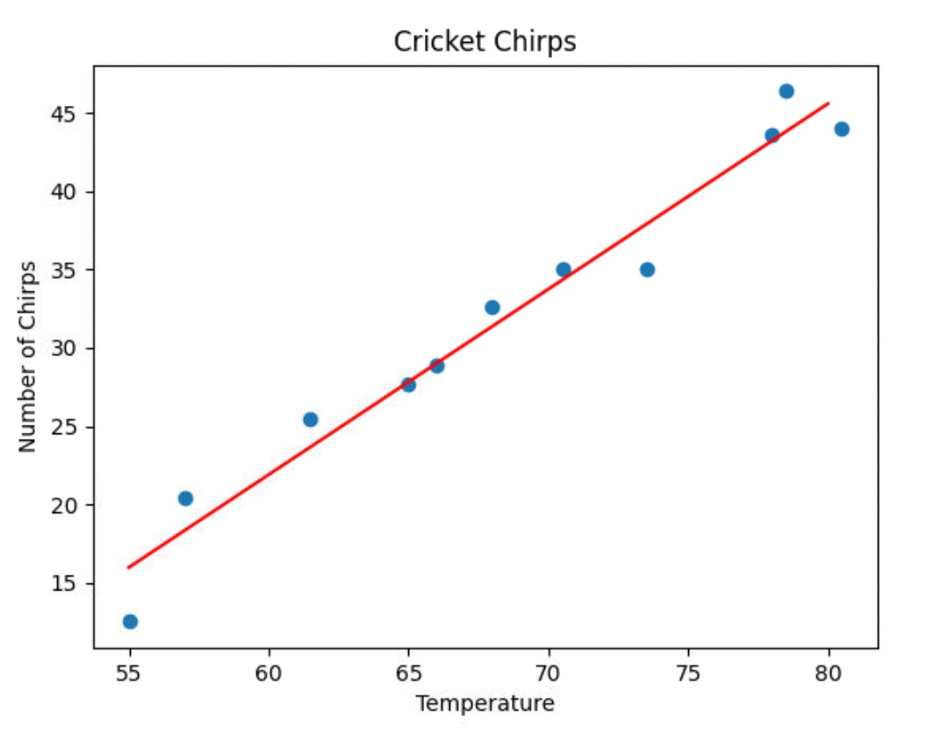
Linear Regression
# Predict using the model
predict = np.poly1d(model)
# Set the y-values of the line of best fit
y_lin_reg = predict(x_lin_reg)
# Plot the line of best fit
plt.plot(x_lin_reg, y_lin_reg, color = "red")
Notes:
Almost done! Now, let’s determine the y-values. This new numpy poly1d () function helps to define a polynomial function - what this means is that it takes the values of our model and creates a linear equation, just as we did earlier. We can then use it to predict the corresponding y-values for the line of best fit. Then, we plot the line using these values. There it is! We just completed linear regression using data.

Slide 36
Linear Regression
# Predict a value
print(predict(60))
21.88620510944454
Notes:
You can also use predict to predict specific values. If we plug in 60 into the line of best fit - it will predict that when the temperature is 60 degrees, the number of cricket chirps should be about 22 chirps per minute. The model is using the x-value of 60 (click) and finding the corresponding y-value of 22 (click).

Slide 37
Lesson Vocabulary
Term | Definition
linear regression | An attempt to create a linear relationship between two correlating variables.
line of best fit | The line that best expresses the relationship between all data points.

